Slide 1
Computer Graphics Basics
Project 1
B10815044 謝鈞曜
B10815057 廖聖郝

Slide 2
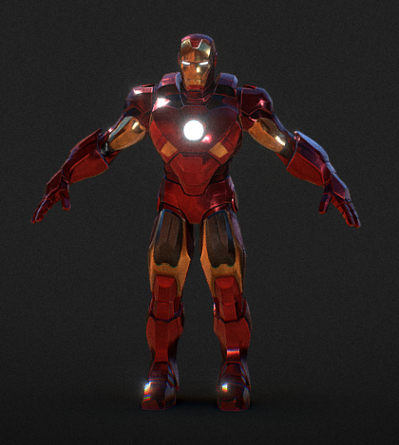
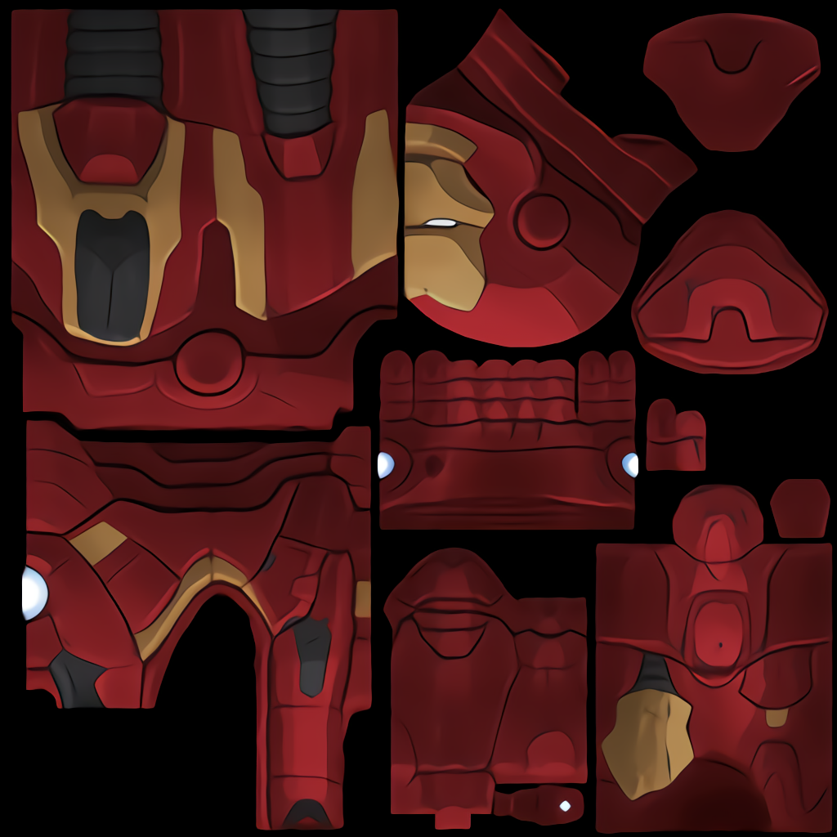
The model we use-Iron Man

Slide 3
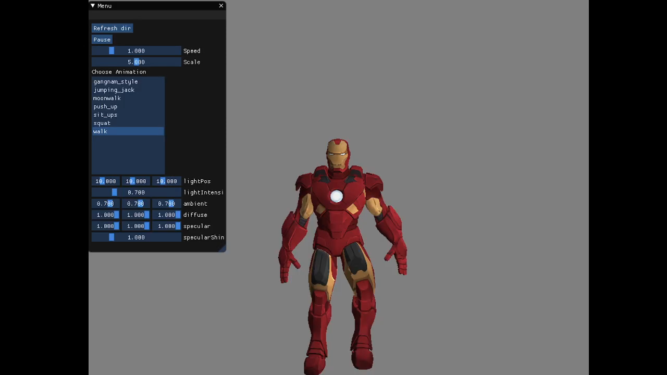
Movement-Walk

Slide 4
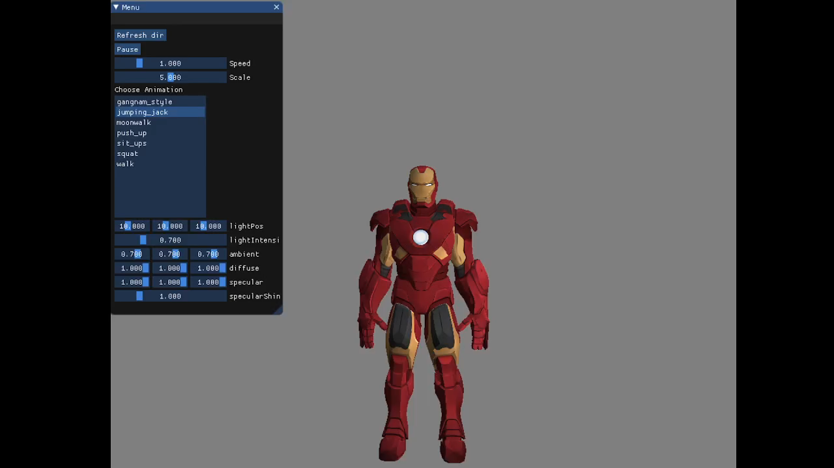
Movement-Jumping jack

Slide 5
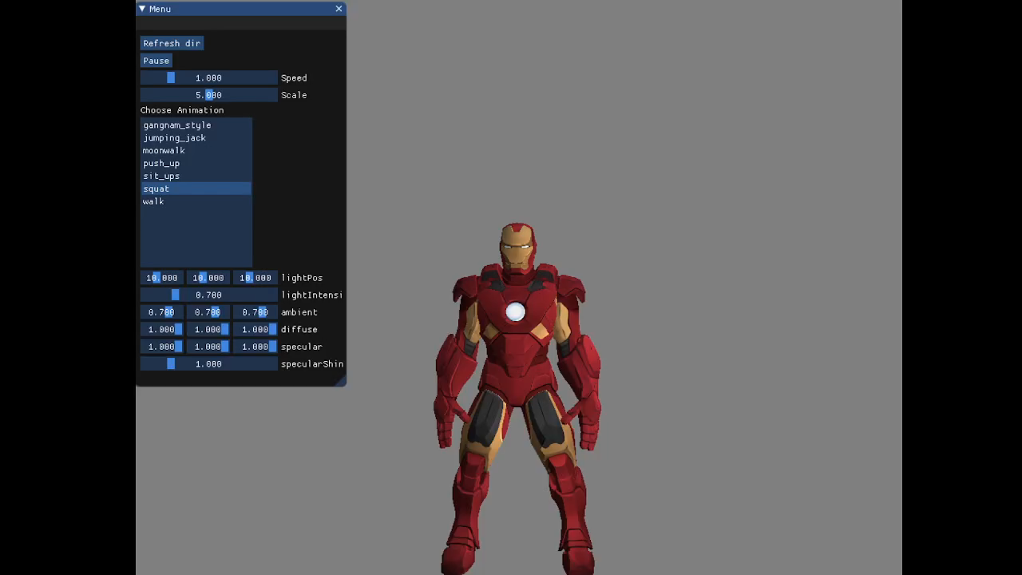
Movement-squat

Slide 6
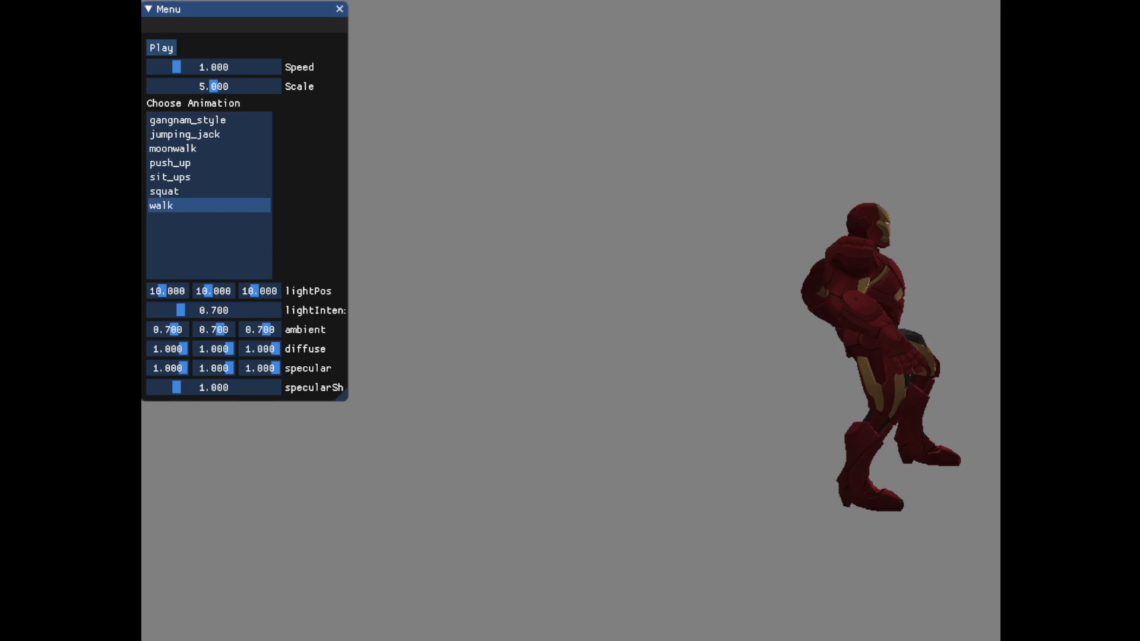
Movement-moonwalk

Slide 7
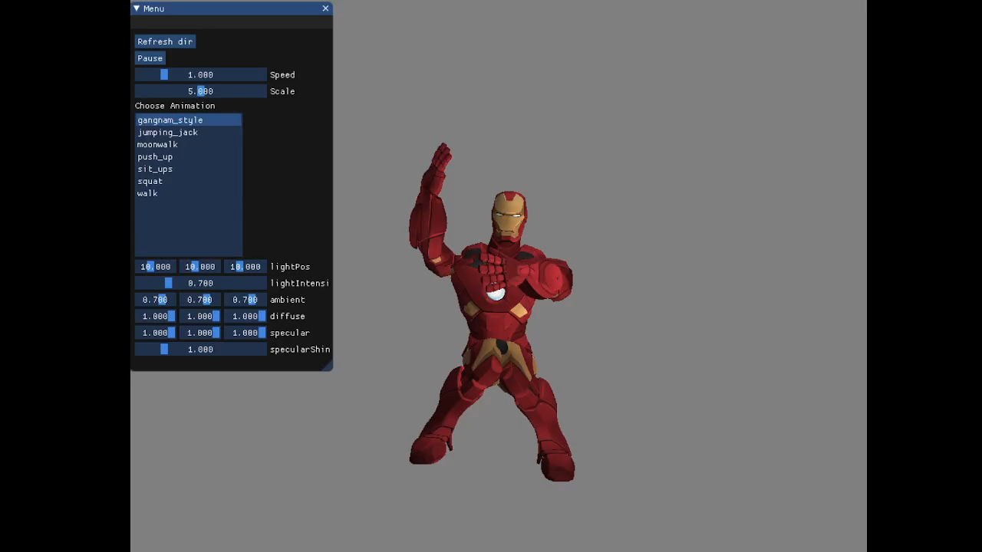
Movement-Gangnam Style

Slide 8
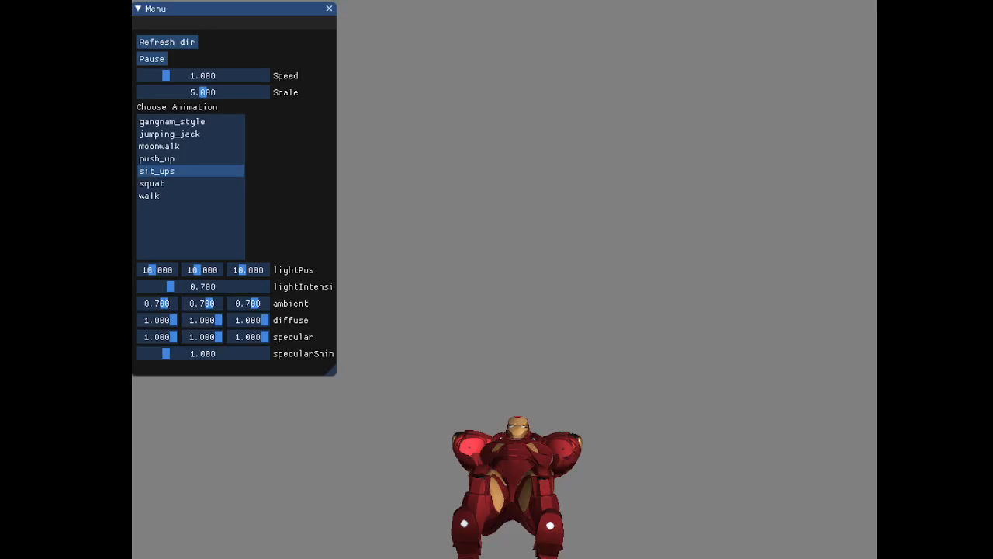
Movement-Sits-up

Slide 9
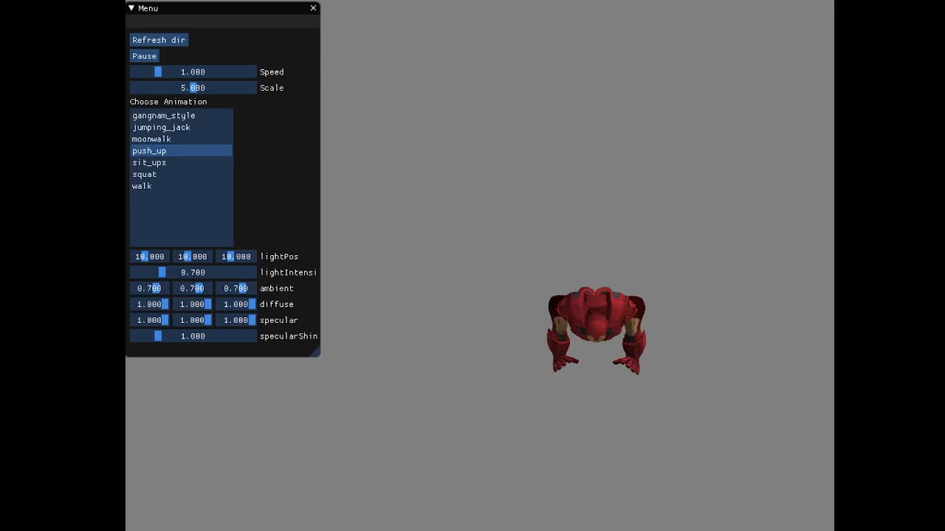
Movement-Push-up

Slide 10
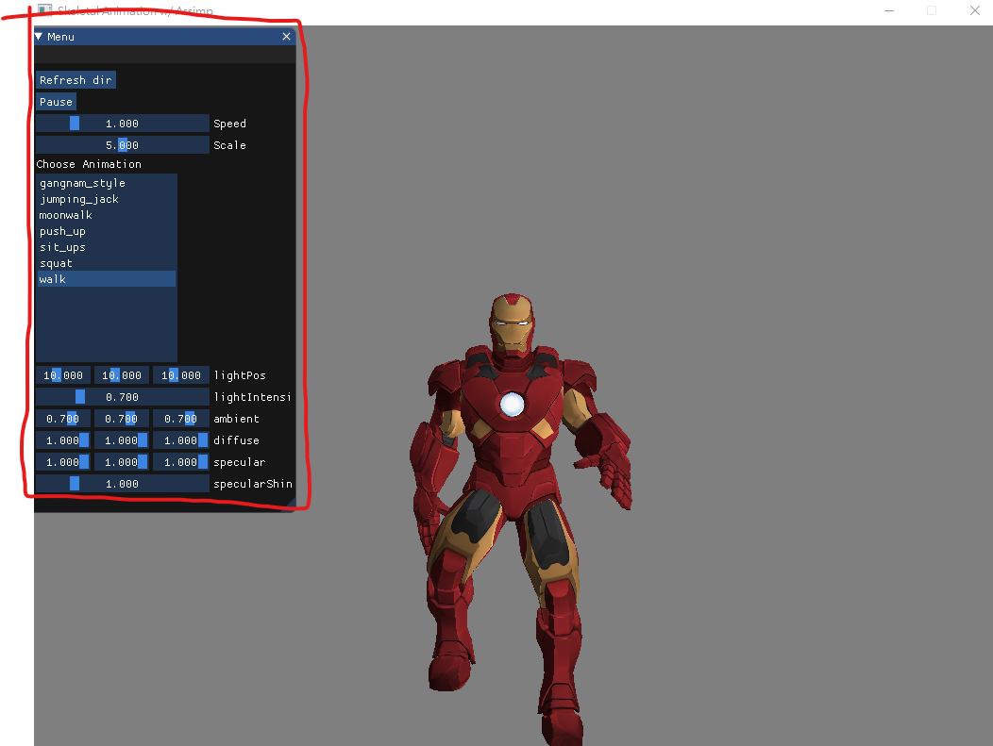
Feature-UI
User can adjust model scaling and animation speed
User can adjust the lights

Slide 11
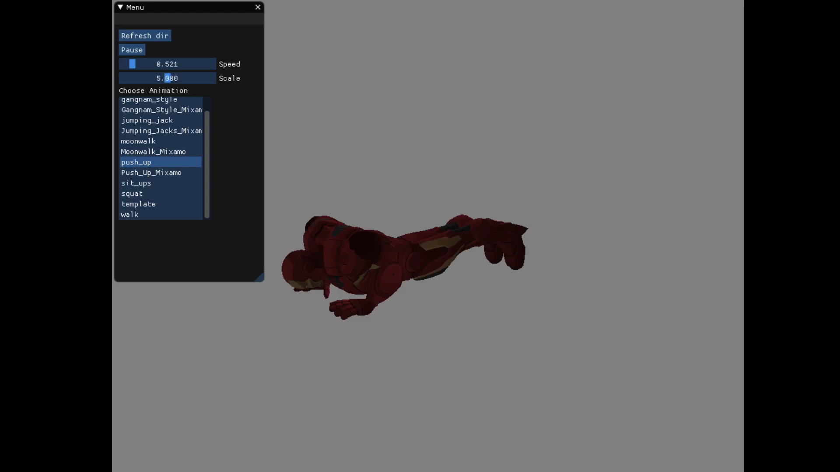
Feature-Hotkey
User can move camera through W,A,S,D, and press “u” can enter rotate mode that allow user to rotate camera.

